Slide 1
Directly Capture Objectives Definition, Principles, and Execution Month Year | Name – Title

Slide 2
Table of Contents
Directly Capture Objectives
Definition............................................................................................4-5
When to DCO.....................................................................................6-11
DCO & Pega Platform......................................................................12-14
Who is involved in DCO...................................................................15-18
DCO in action...................................................................................19-24

Slide 3
DCO Definition & Principles

Slide 4
DCO
Directly Capture Objectives ( DCO) is Pega's way of working from the start of the project through to the end.
DCO encourages alignment between the stakeholders and drives high-quality engagement between business and IT.
DCO places the focus of the application design, and build, on achieving the business outcomes, a human-centered design, and iterating the delivery to realize business value quicker.

Slide 5
DCO is…
DCO is a discipline and a way of working that forms a continuous cycle of collaborating, iterating, and then validating.
Business and IT people work closely together to model the final application, step by step.
We visual tools to capture outcomes, design screens, workflows, and feedback all inside Pega.
A discipline
A way to work
A continuous cycle
Notes:
We previously stated DCO is:
A discipline
A way to work
A continuous cycle
We take 3 actions to execute on these principles. The actions are collaboration, iteration, and validation.
The DCO principle of a discipline is we ALWAYS collaborate, iterate, and validate with one another.
The DCO principle of a way to work is we SEQUENCE from collaboration, to iteration, and then to validation.
The DCO principle of a continuous cycle is we REPEATEDLY collaborate, iterate, and validate as we progress through the discover, prepare, build, and adopt phases.

Slide 6
When to DCO
READ & DELETE BEFORE USING
To change the background photo on this slide, Right Click > Format Background > Fill > Picture or Texture Fill and select a new photo. If selected photo is not 16:9 proportion, it will be proportionally scaled to fit.

Slide 7
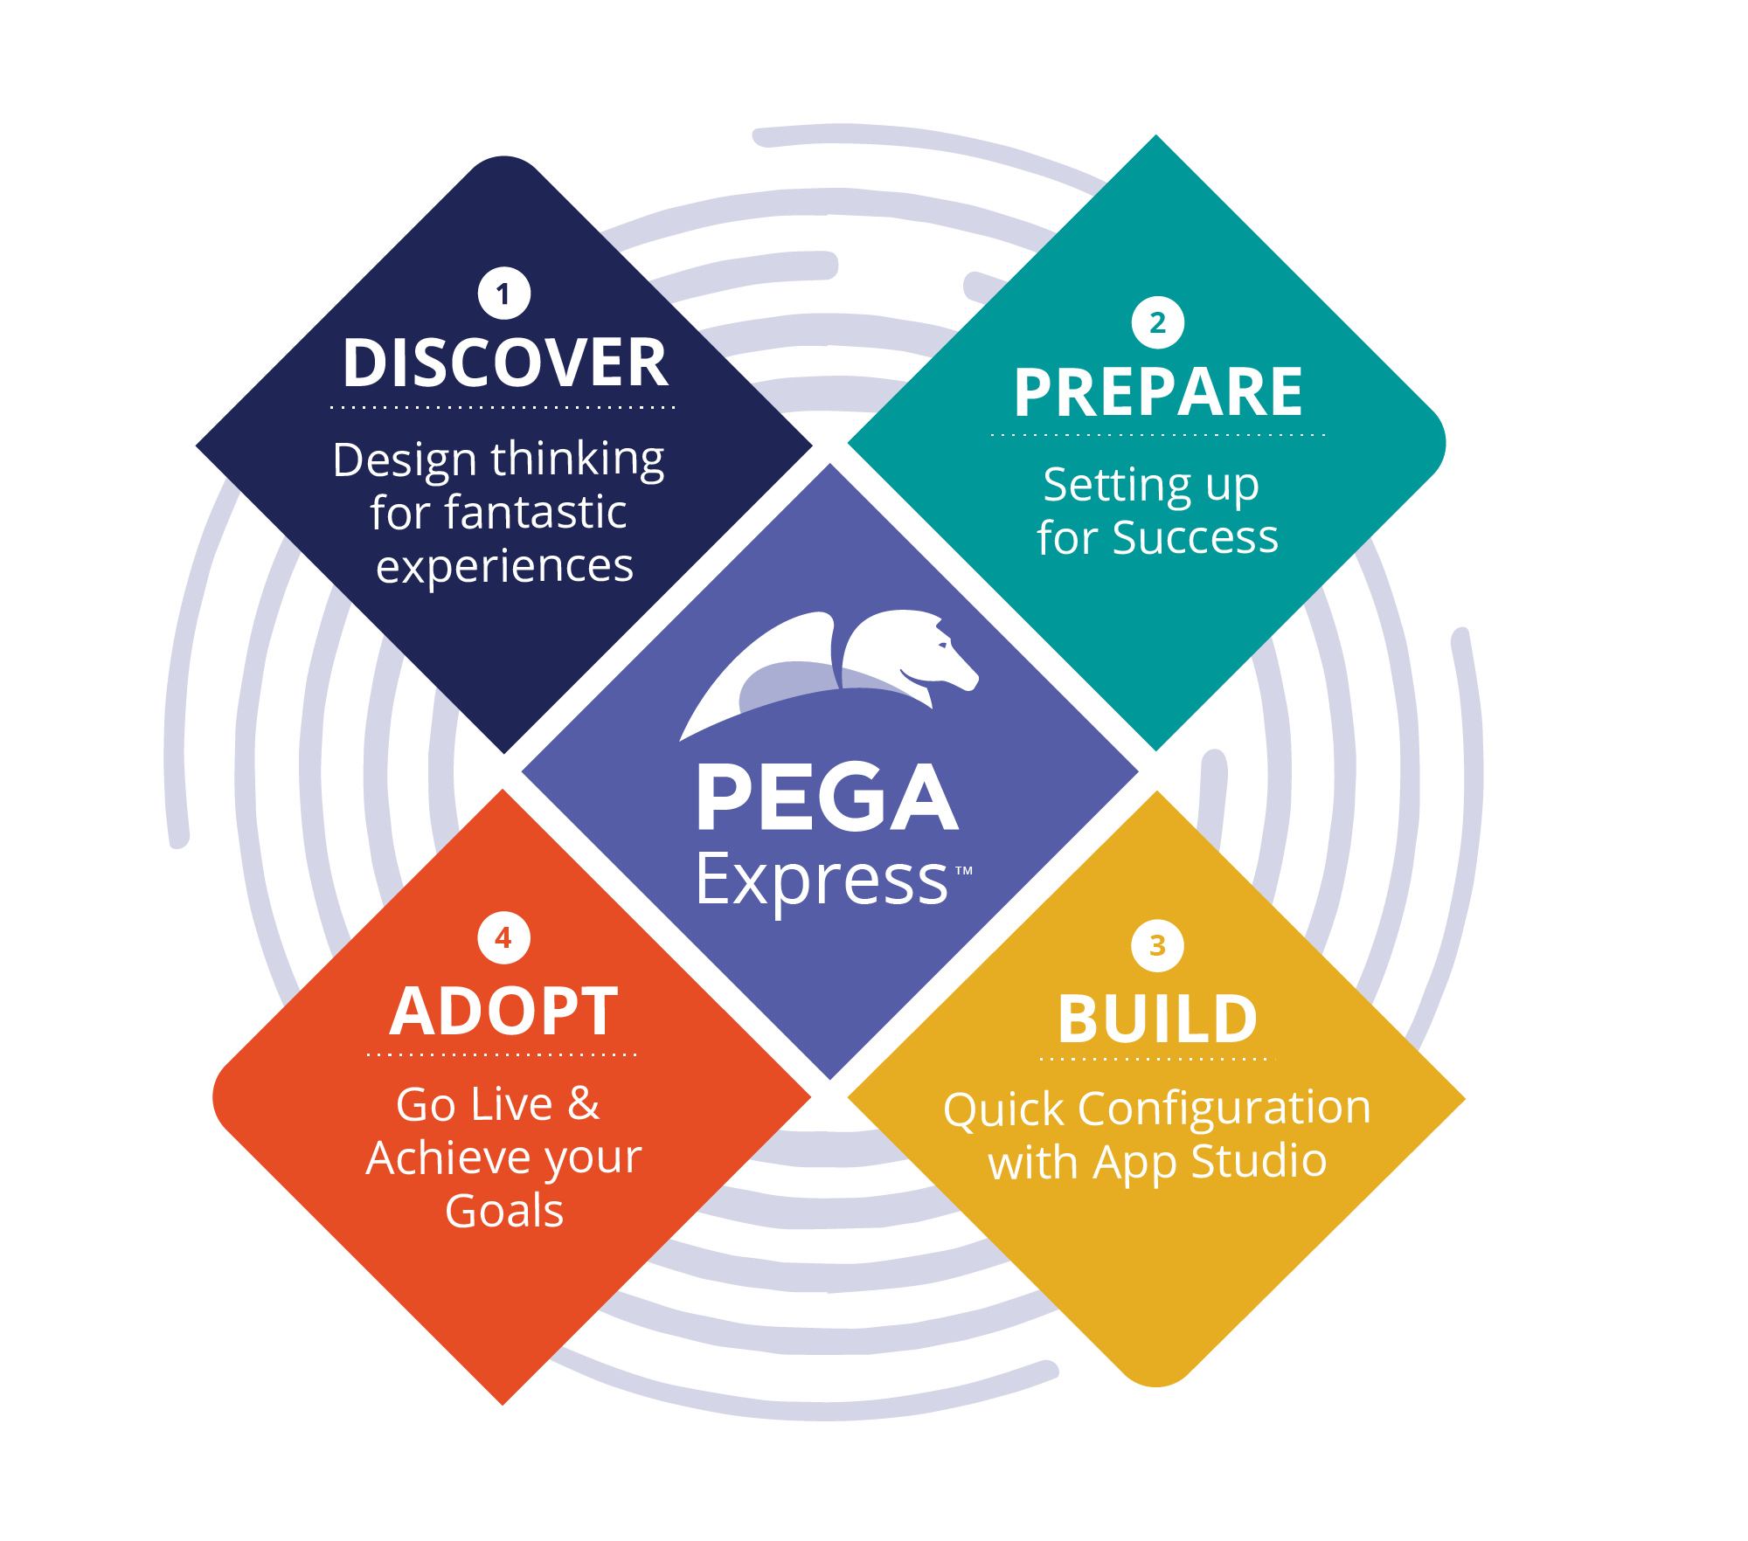
When to DCO
Initiate
Initiate
At Pega, we use DCO throughout the project lifecycle to work collaboratively with the business and IT colleagues.
Each phase within the lifecycle uses the discipline of DCO to achieve the deliverables and outcomes appropriate for that phase;
Notes:
Pega Express is the prescriptive methodology for Pega solution delivery. DCO supplements Pega Express. It provides the principles to ensure the Pega solution delivery is efficient and effective.

Slide 8
DCO During Prepare
Initiate
Initiate
At the start of the project, during Prepare the focus of DCO is on
exploring the microjourneys identified during Discovery and translating them into Pega's case types, user roles, and data model.
Establishing the backlog and the initial set of stories and finalize the technical architecture.
Baseline and confirm that the design will yield the agreed business outcomes.
Notes:
Pega Express is the prescriptive methodology for Pega solution delivery. DCO supplements Pega Express. It provides the principles to ensure the Pega solution delivery is efficient and effective.

Slide 9
DCO During Build
Initiate
Initiate
During the project, as part of the Build phase, the focus of DCO is on
taking feedback via in-sprint playbacks to validate the current sprint output is producing an application that meets the business objectives.
Incorporating testing results in the feedback loop with the business to allow the team to make adjustments to keep the project on track for meeting the MLP.
Maintaining the backlog and refining user stories for future sprints
Notes:
Pega Express is the prescriptive methodology for Pega solution delivery. DCO supplements Pega Express. It provides the principles to ensure the Pega solution delivery is efficient and effective.

Slide 10
DCO During Adopt
Initiate
Initiate
At the end of the project during the Adopt phase, DCO is used to continue gathering feedback.
Once the application has gone live, there are opportunities to run formal user reviews to gain insights on the user experience. The findings from these sessions can be used to extend the product backlog with additional stories.
Notes:
Pega Express is the prescriptive methodology for Pega solution delivery. DCO supplements Pega Express. It provides the principles to ensure the Pega solution delivery is efficient and effective.

Slide 11
DCO puts all required artifacts directly in the Pega platform
Case Types
User Interface Designs
Backlog
Business Outcomes
Personas
Epics
Stages & Steps
(Workflow)
Data / Integrations
User Stories
Channels
Feedback

Slide 12
DCO & Pega Platform
READ & DELETE BEFORE USING
To change the background photo on this slide, Right Click > Format Background > Fill > Picture or Texture Fill and select a new photo. If selected photo is not 16:9 proportion, it will be proportionally scaled to fit.

Slide 13
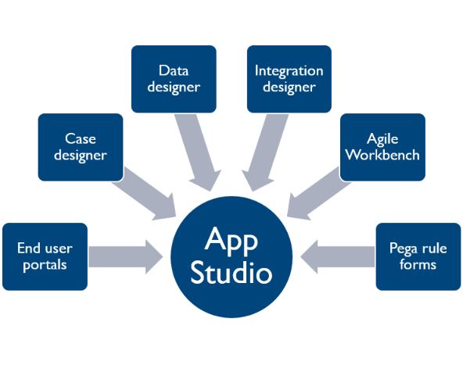
DCO and App Studio
The Pega platform has a vast array of studios and visualization tools that can help get the most out of the DCO session and enables you to directly capture requirements.
This helps speed up delivery, generating a shared repository of what should be developed, and removing the need to spend hours documenting after a session

Slide 14
DCO and App Studio
Case Designer
The case designer can help visualize the process and develop a shared understanding of what will happen in a process
Data & Integration designer
The data designer and integration designer can help show what data is present or consumed by the application, ensuring the right information is used by the system to complete a process.
Agile Workbench
Agile workbench integration can integrate directly with your Agile Project Management tool. Showing user stories live, and allow teams to update these in real time. It also provide a power tool to raise bugs or feedback that can be address by the agile team.
End user portals can help play back the process or quick changes in real time
End user Portals
Pega Rule forms
Pega rule forms can display business rules used execute your process, ensuring the correct business logic is executed.

Slide 15
DCO – who is involved
READ & DELETE BEFORE USING
To change the background photo on this slide, Right Click > Format Background > Fill > Picture or Texture Fill and select a new photo. If selected photo is not 16:9 proportion, it will be proportionally scaled to fit.

Slide 16
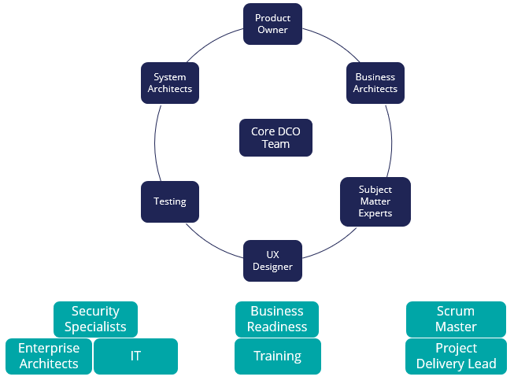
DCO – Who is involved
The stakeholders involved in DCO cover several disciplines from both the business and technology.
The core team should be small with representation from the business including .
DCO stakeholders are not limited to the core team.
An extended group of stakeholders from the business and technical teams are often required to support application design

Slide 17
DCO Core Team
Business architect
A business architect will help educate the core team on Out of the Box Pega components that are available to address the business requirements. They will ensure the user stories are generated or updated ensuring the backlog is up to date with the latest details.
Subject matter expert
Subject Matter Experts (SME) will support the product owner with detailed know-how and business requirements for specific areas of the business and the application
User experience designer
A user experience designer will help guide a superior user experience and in some cases provide wireframes to support application development
The product owner provides the vision, direction and scope for the application.
Testing
Testers help ensure that the test team understand the functionality that is being developed and can plan out their test scripts accordingly.
They are responsible for ensuring the business is appropriately represented at DCO sessions and is equipped to provide high quality requirements into the DCO sessions.
A system architect will help provide the experise on what is possible using Pega Out of the Box approaches to help find they most effective way to deliver the business requirements
System architect

Slide 18
DCO Extend Team
Enterprise
architect
Security speciality
IT
Training
Business Readiness
Scrum Master
Project Delivery Lead
The extended team specialists, needed for the application to successfully integrate into the organization's existing technical and business architecture will be called upon by the core team as and when required .
The scrum master and the project delivery managers will help to ensure the smooth running of the scrum team and the project as a whole. They provide an escalation path to resolve issues, coordination between external stakeholders and the core team.

Slide 19
DCO in Action
READ & DELETE BEFORE USING
To change the background photo on this slide, Right Click > Format Background > Fill > Picture or Texture Fill and select a new photo. If selected photo is not 16:9 proportion, it will be proportionally scaled to fit.

Slide 20
Prerequisites
Culture supports transformational change
Agile/Pega Express leveraged as delivery methodology
Business and IT resources are appropriately enabled, allocated, and empowered
Notes:
There are two cultural components that support transformational change:
Communicate how the new approach, behaviors, and attitudes bring about the desired outcome, and not the charismatic individual championing it or hard working team implementing it
Identify and ensure the next generation of management personifies the transformational approach, behaviors, and attitudes, so these are not lost once the leader moves on or the project is complete
The are also two software development components that support transformational change:
Strategic initiatives defined by senior leadership and initiated through software projects
Agile methodology employed whereby production ready software gets deployed incrementally to the business
Also, we need to develop our solutions from a customer perspective. Consequently, business and IT resources working on the project need to understand the customer needs, the current state, and how the current state falls short in exceeding the customer needs. They also need to have knowledge of Pega technology. This will facilitate the development of a solution that exceeds customer expectations.
Just importantly, the business and IT resources need the time and the authority to make decisions to establish a future state that exceeds customer needs. This means resources need to focus on the project, and therefore, should have their day-to-day responsibilities temporarily shifted to others.
The course Empowering the Business Owner on Pega Academy is a good reference on prerequisites for DCO. You can share the following URL for course registration: https://academy.pega.com/library/71/empowering-business-owners
DCO inputs are the vision, business outcomes, personas, journeys, gap analysis/prototype, and roadmap. These are necessary inputs to initiate and execute DCO. If they are not shared or incomplete, we need to allocate time to define and develop these inputs so we may successfully execute DCO.

Slide 21
Goals
Leverage out-of-the-box (OOTB) capabilities to automate processes and create efficiencies
Align business and Development Team on business objectives, outcomes, and design solutions
Streamline documentation by developing, enhancing, and approving a design solution directly in Pega
Notes:
By meeting these goals, we ensure Pega solution delivery is efficient and effective. This is a result of successfully enacting our DCO principles.
Emphasize the following for each of goal.
Leverage OOTB capabilities: Pega provides OOTB capabilities that help jump start solution design and development activities.
Align business and Development Team: Associating business objectives and outcomes with a design solution mitigates misunderstandings and scope creep.
Streamline documentation: Visual modeling allows us to walk through the design solution and make enhancements to it in real-time.

Slide 22
DCO STEPS
Preparing to DCO,
Running the DCO session,
Performing any post DCO session follow-up,
Running a playback, and
Gaining approval.

Slide 23
DCO Sessions & Playbacks
Inputs
Activities
Outputs
Status
Ready for DCO Session
Artifacts
Prep
Draft Stages, Steps, and UI
Draft User Stories
Vision & Business Outcomes
Personas & Journeys
Gap Analysis or Prototype
Roadmap
Minimal Lovable Product
Session
Collaborate
Iterate
Incorporate feedback from DCO Session
Ready for DCO Playback
Post
Refine Stages, Steps, and UI
Refine User Stories
Ready for
Approval
Iterate with mini-playbacks as necessary
Incorporate feedback from Playback Sessions
Playback
Collaborate
Iterate
Validate
Sign off
Approvals
Stages, Steps, and UI
Sprint Ready User Stories
23

